Slide 1
Overview of Part 213 Amendments Senate Bill 717 – Act 381 of 2016
Kevin Schrems
Michigan Department of Environmental Quality
517-284-5149/ schremsk@michigan.gov

Slide 2
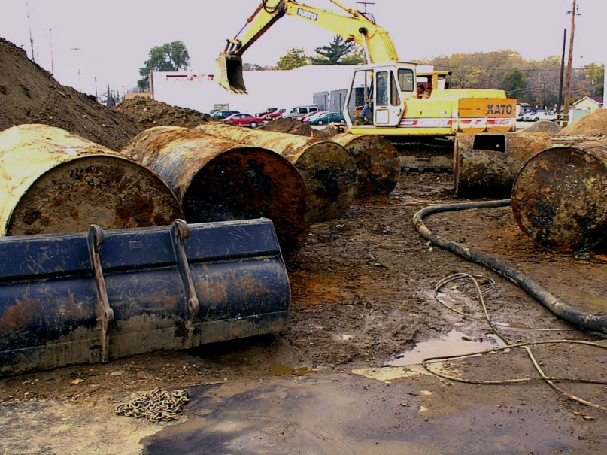
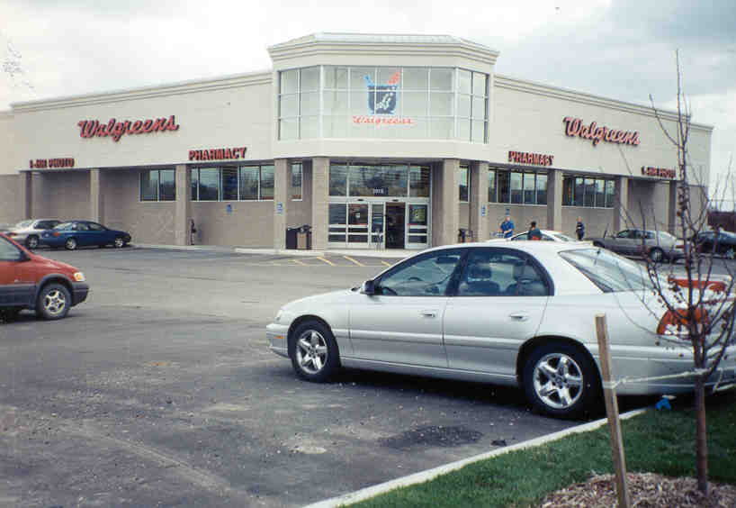
Roadmap of Presentation
Chronology of Senate Bill 717
Walk-through of Amendments
Special attention to Public Highway IC
Questions
Before After

Slide 3
“I’m Just a (SB 717) Bill”
Introduced by Senator Casperson on 1/21/2016
Passed by Senate on 4/12/2016
Introduced in House on 4/12/2016
Read a first time (4/12/2016) and referred to Committee on Natural Resources.
Committee reported (9/20/2016) out with recommendation (substitute H-1)
Read a second time (12/1/2016)
Substitute H-1 adopted (12/1/2016)
Placed on third reading (12/1/2016)
Passed by the Senate on 12/7/2016
Signed by the Governor on 12/21/2016
Effective Date – March 29, 2017

Slide 4
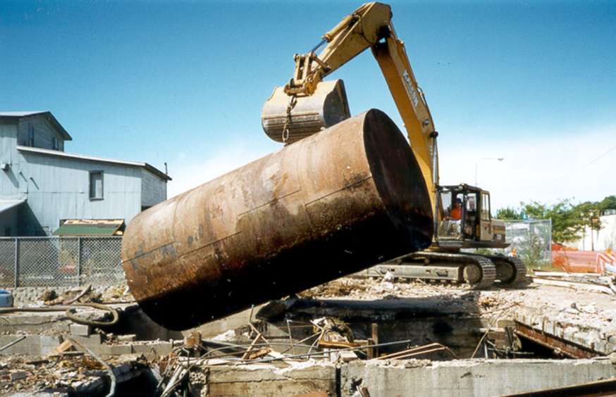
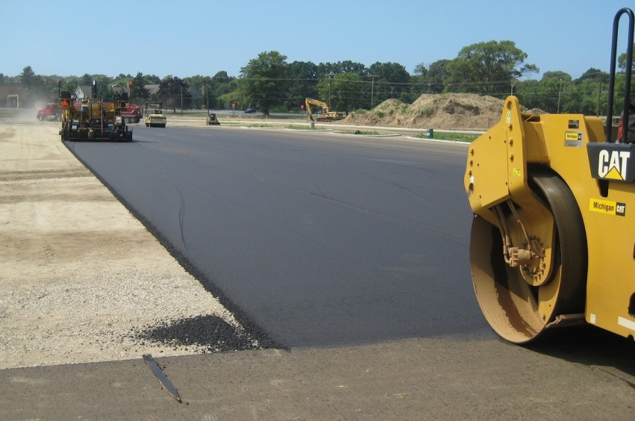
Short Summary
SB 717 expands the types of allowable land use or resource use restrictions used to facilitate closures under Part 213.

Slide 5
Land Use or Resource Use Restrictions A Brief Primer
When contamination remains at a property above generic residential criteria, a land or resource use restriction may be used to address the remaining risk if:
LRUR is protective, and
Persons who own and use property have knowledge.
Restricted (limited) categories exist for circumstances that require restrictions on the use of property, such as:
Not allowing residential or institutional uses
Protect integrity of remedy, such as exposure barriers (i.e., paving)
Prohibitions on resource use (i.e., don’t drink the groundwater) to keep people from being exposed to contamination now and in the future.

Slide 6
Understand the Difference ECs vs. LRURs
Engineering controls (Physical)
vapor barriers, physical or hydraulic containment, asphalt/concrete, vapor mitigation fans, etc.
LRURs (Paper / Legal)
“Institutional Controls*” (EPA)
Protects integrity of EC or minimize potential for human exposure to contamination

Slide 7
Part 213 – Amendments Due Care
Clarifies due care obligations do not apply to a road comm. or LUG for public highway.
Except to comply with a LRUR (aka IC).
Adds provision to impose all due care obligations on a liable O/O.
Specifically for regulated substances present within public highway.

Slide 8
Part 213 – Amendments Institutional Controls
Eliminates impracticality requirement prior to selecting ICs other than a RC.
Instead of “reliably restrict exposure”, the selected IC “protects against exposure”.
Adds to listed alternative mechanisms to include:
State law or rule, license/license agreement with MDOT, and reliance on public highway (local).
Note – Part 213 now has definition for public highway.

Slide 9
Part 213 – Amendments ICs – Public Highway (2 Scenarios)
If MDOT “fails or refuses” to grant or enter ELA w/in 120 days,
And for public highways owned/controlled by road comm. or LUG,
O/O may rely on existence of public highway.
O/O must complete 3 tasks (details next slide)
Technical information
LUG confirmation
Storm sewer certification

Slide 10
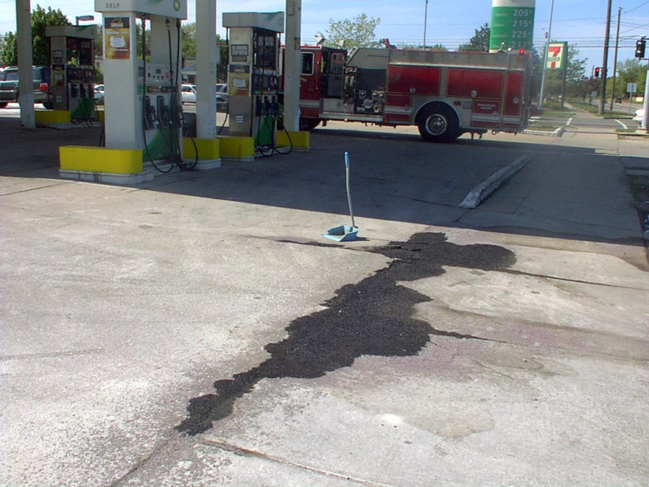
Part 213 – Amendments ICs – Public Highway
Provide technical information,
Confirm no current plans to relocate, vacate, or abandon public highway, and
Provide certification that either contamination does not enter storm sewer system or provide all information regarding nature/extent of contamination that enters or has potential to enter.

Slide 11
Part 213 – Amendments ICs – Public Highway
Adds requirement that a person who applies for a permit to perform work within public highway shall identify whether the proposed work will take place within AIC area
Also includes provision that reliance on public highway does not impose liability on MDOT or LUG
Or prevent those entities from repairing, reconstructing, enlarging, relocating, etc. the public highway or permitting any utilities to use public highway.

Slide 12
MDEQ RRD Publishes “Public Highway Institutional Control” Form
March 14, 2017 - GovDelivery notice.
Replaces former “Road Right-of-Way Alternate Institutional Control” document.
Equivalent information presented in alternate means will be reviewed by DEQ.
Previous reports or plans approved by DEQ using previous form remains valid.

Slide 13
Public Highway Institutional Control
A lot like ROW AIC
Structure matches Part 213
Allowed under Part 201
Available on Storage Tank Information Center Webpage
And Part 201 Forms and Documents page

Slide 14
Part 213 – Amendments BEAs
Adds a provision for O/O to request inconsequential determination from dept.
O/O conducts a BEA.
Failure to meet 45-day statutory timeframe for conducting BEA or failure to provide BEA to Dept. and subsequent purchaser or transferee within 6 months was inconsequential.
If O/O receives an inconsequential determination, they maintain liability exemption

Slide 15
Part 213 – Amendments Liability
Revises the liability protections provided by an approved Closure Report that relies on land or resource use restrictions.
Amendments now make a liable owner or operator responsible for additional corrective action:
to address any increased risk if any alternate mechanism is modified, lapses, or is revoked or a public highway is relocated, vacated, or abandoned.

Slide 16
Part 213 – Amendments RBCA
Adds a provision that requires DEQ employees to be formally trained and demonstrate proficiently in Risk Based Corrective Action.

Slide 17
Questions?
Kevin Schrems
Remediation and Redevelopment Division
Compliance and Enforcement Section Enforcement Unit
517-284-5149
schremsk@michigan.gov

